Slide 1

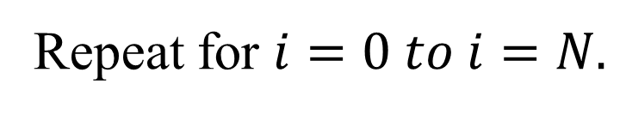

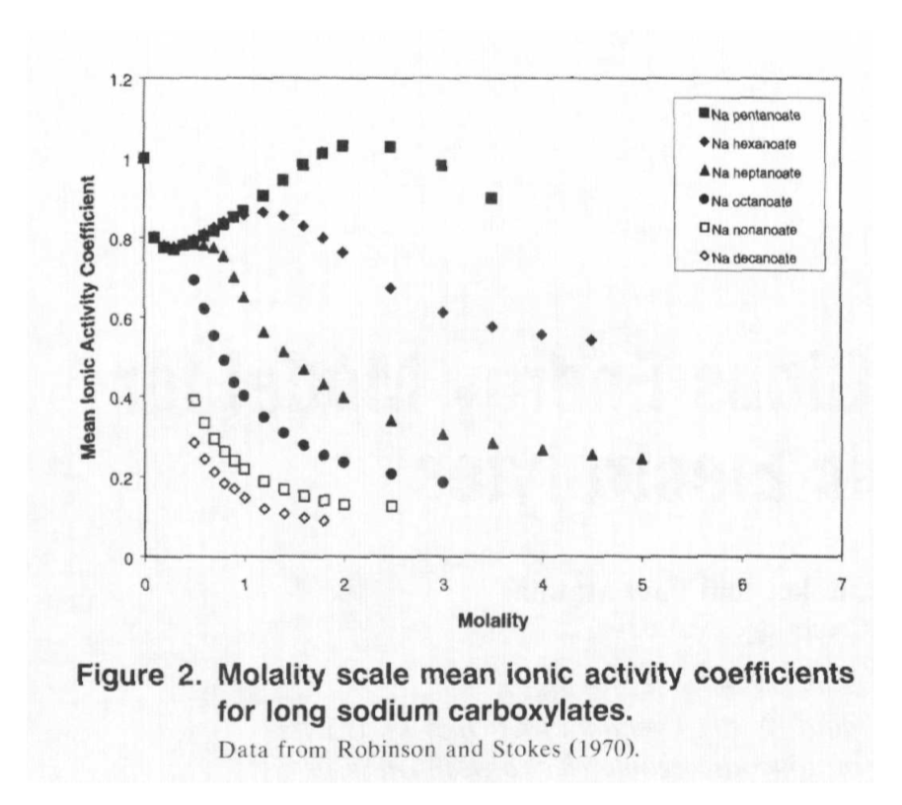
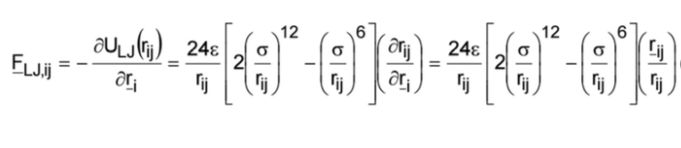
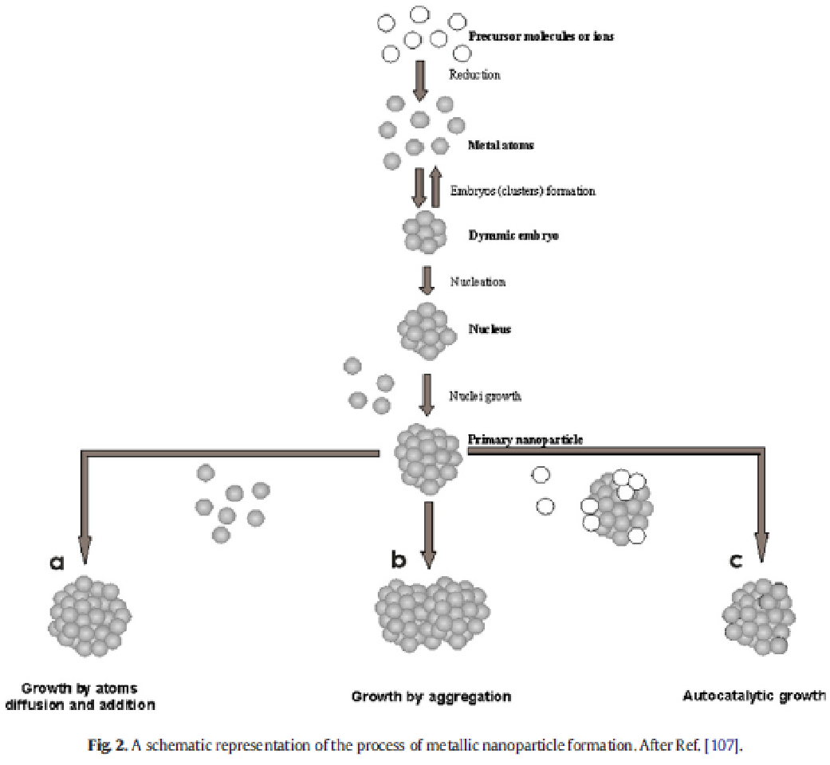
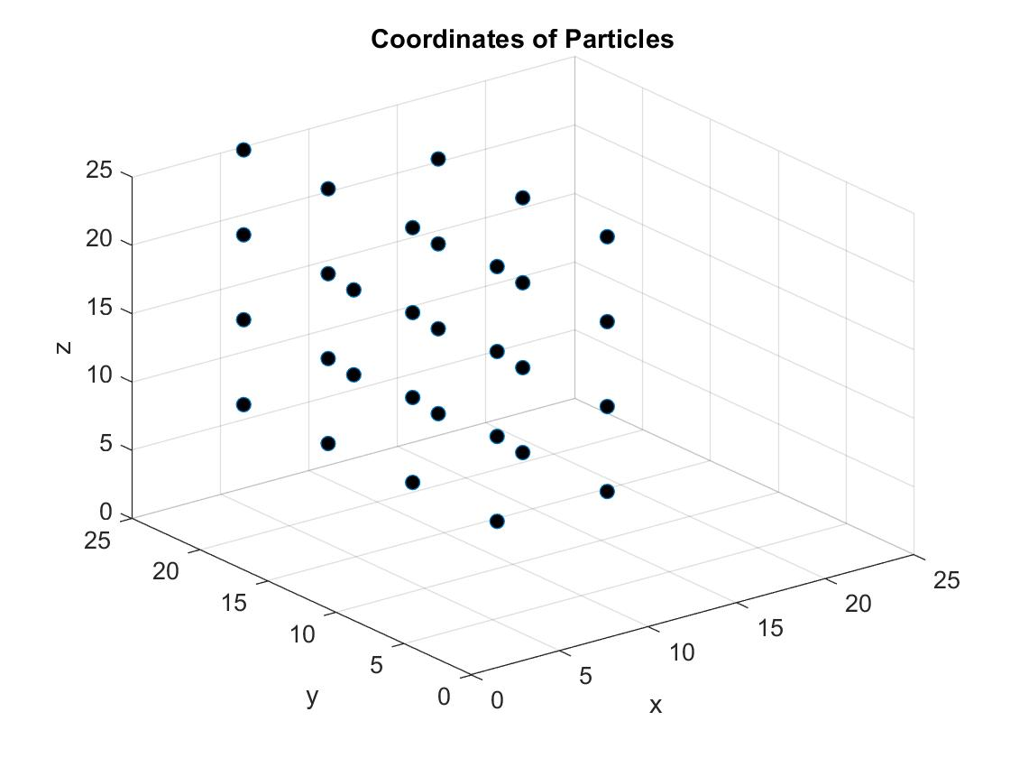
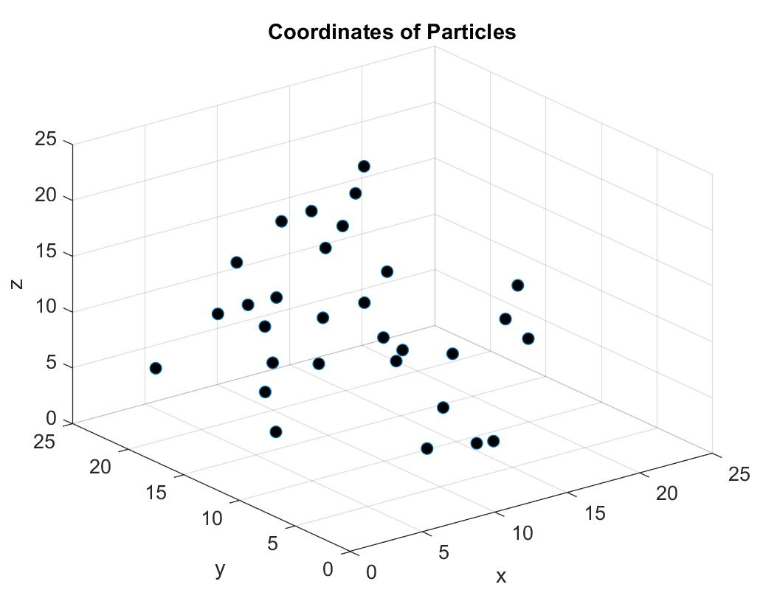
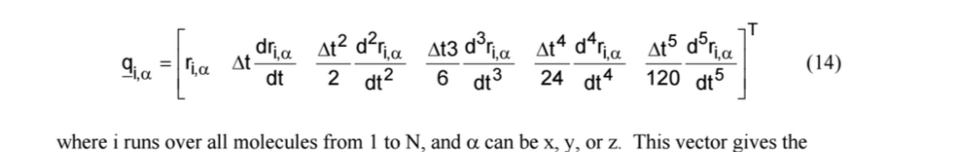
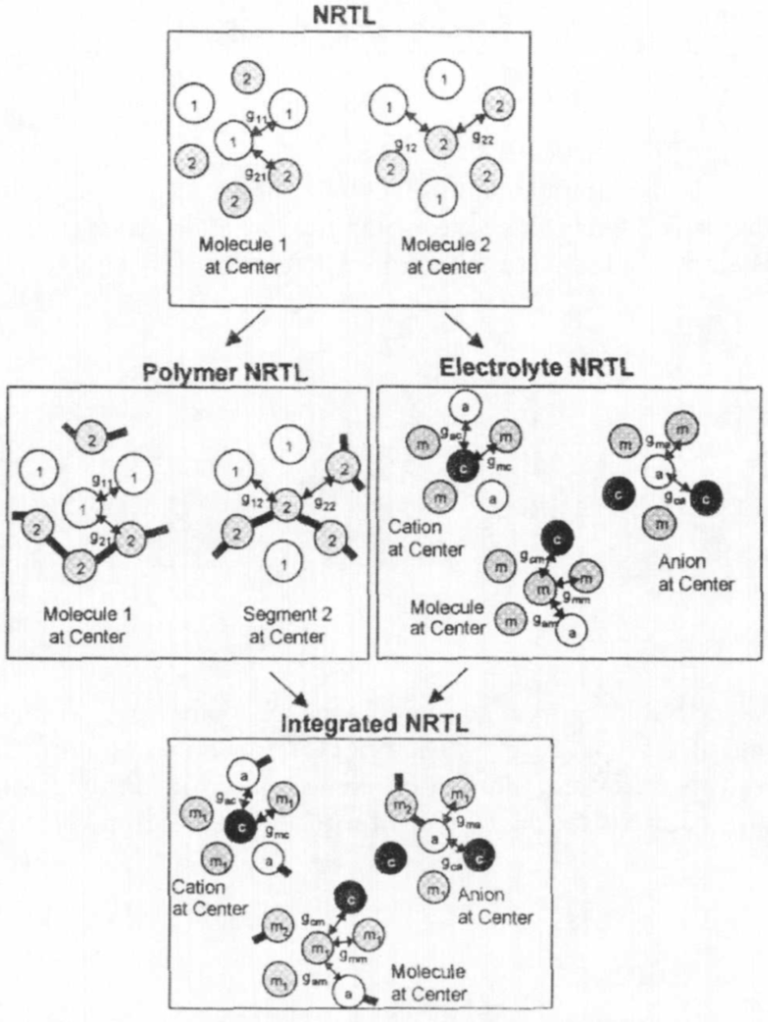
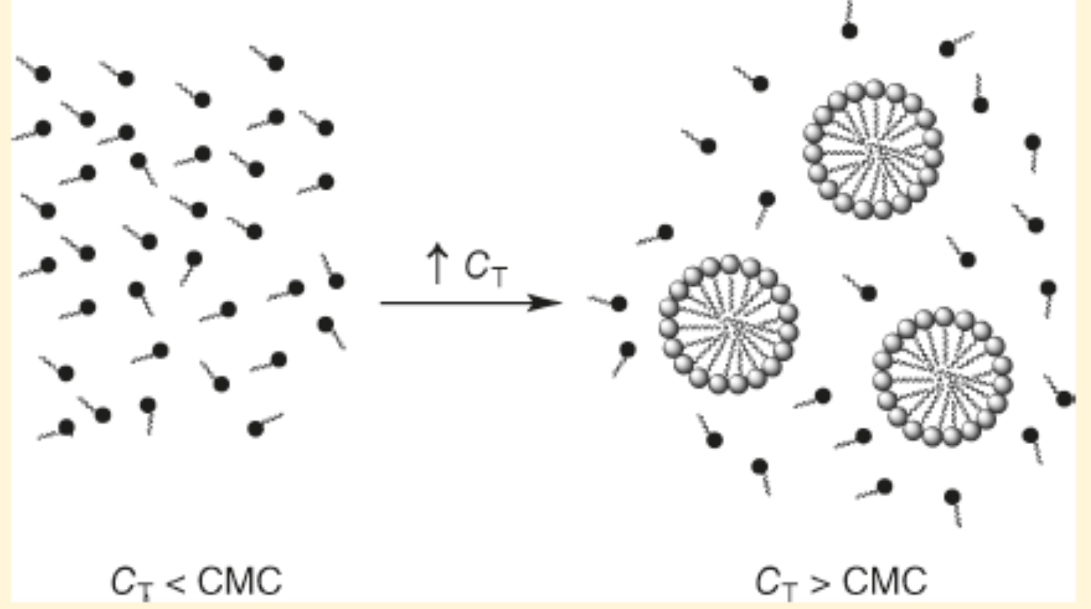
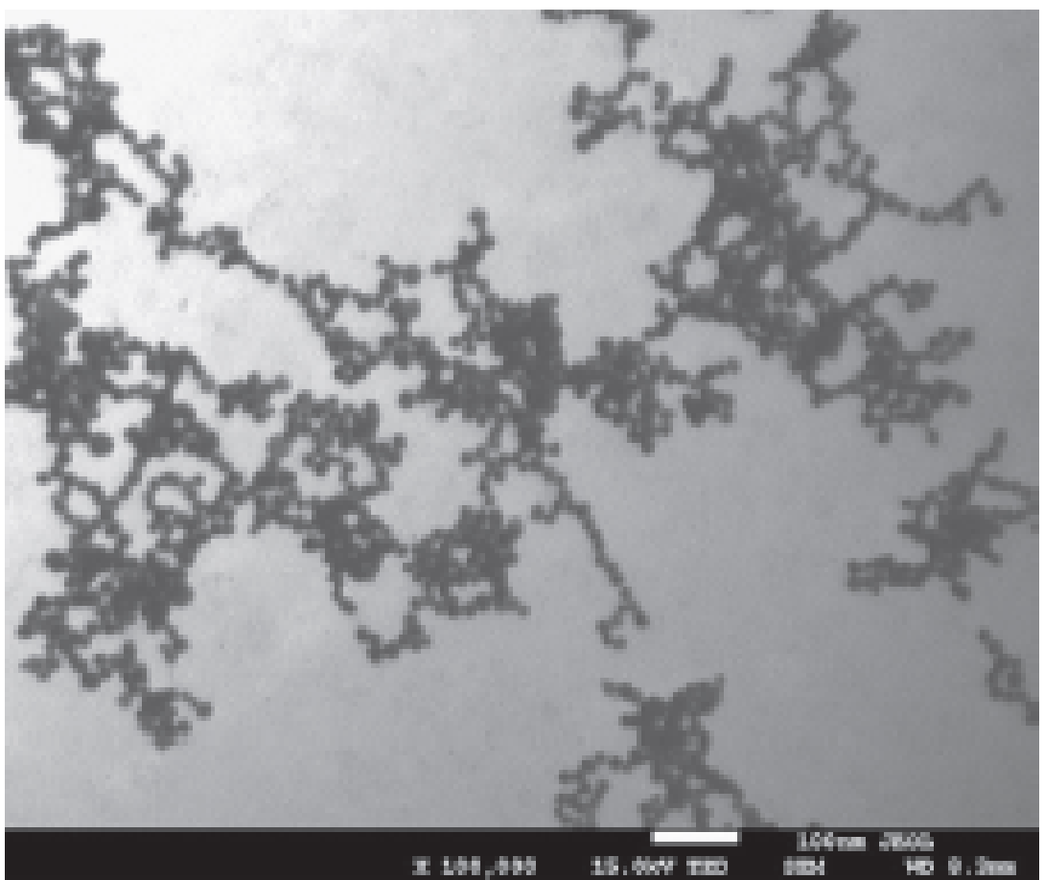
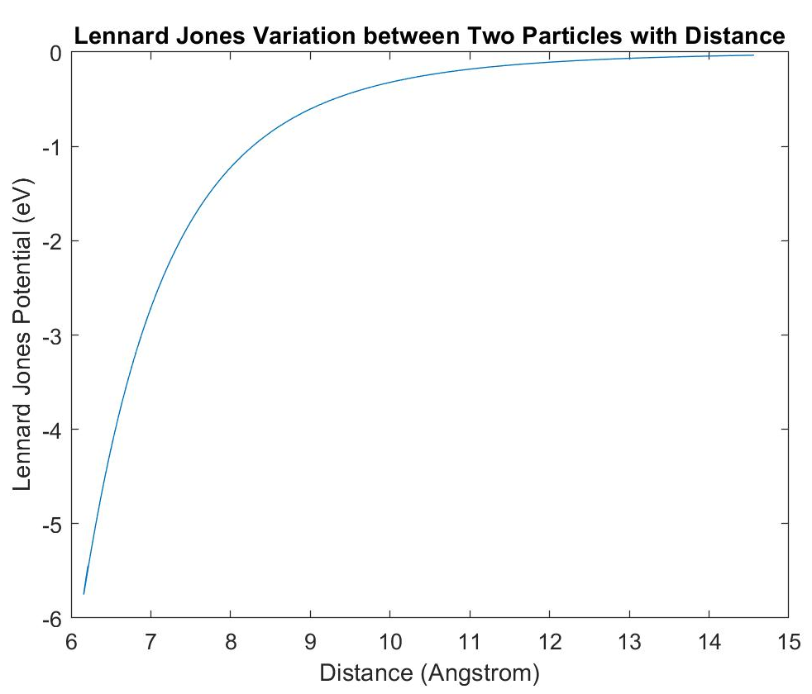
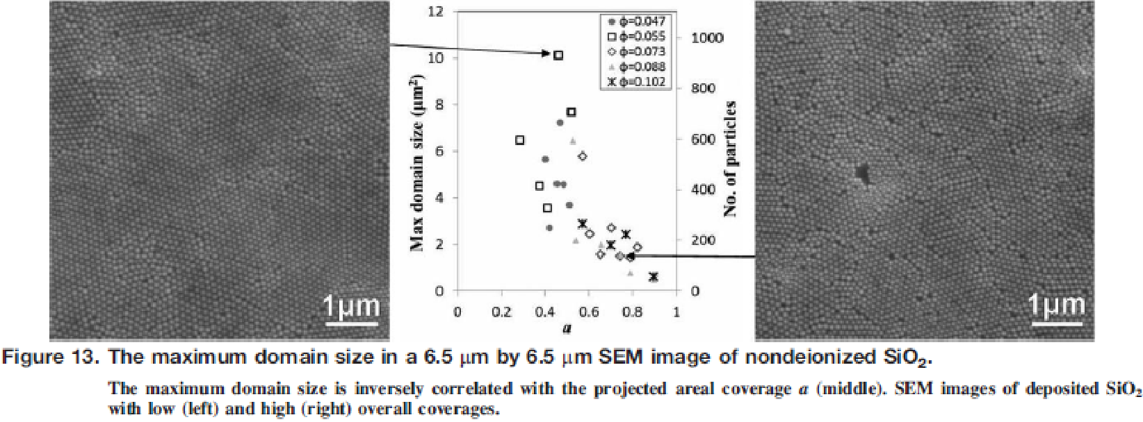
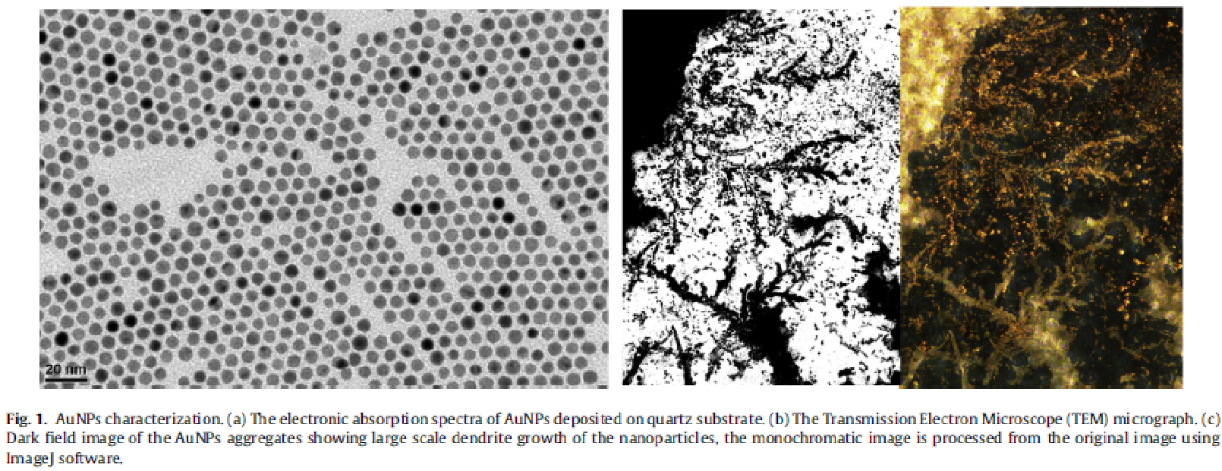
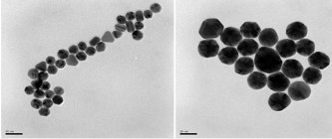
Simulation of Nanoparticle Aggregation
Ayo Adebisi, Colin Breslin, Alan S. S. Daou
Faculty Advisor: Dr. James Brenner Dept. of Chemical Engineering, Florida Institute of Technology
Abstract
Algorithm
For particle i sort neighbor list by distance, where nearest neighbor gets index 0.
In each time step, we must account for
A) any metal ions or atoms diffusing
B) any metal ions or atoms convectively moving due to ion currents
C) any nanoparticle (NP) diffusion
D) any NP convective motion
E) possible reaction between all combos of
1) two isolated metal atoms/ions
2) one metal atoms/ions + one NP
3) two NP's
F) Surface diffusion of metal within a NP to minimize NP energy
G) Include formation of grain boundaries
H) Include coalescence of two adjacent grains into one larger grain
Control over the distribution of particle sizes is central to the nanotechnology industry, particularly with regard to color, electrical properties, catalytic behavior, sensing by electronic noses and tongues, and all other surface properties. To make this possible, nanoparticles (NPs) are typically surrounded by either cationic or anionic surfactants to put a surface charge on the NP’s, thereby ensuring repulsion with similarly charged NP’s. Sometimes NP’s are surrounded by nonionic capping agents that rely solely on the steric bulk of the capping agent to provide a barrier to NP aggregation. Often, capping agents are chosen to provide both an electrostatic and a steric barrier to aggregation.
This project will involve the development of a hybrid Monte Carlo (MC) and molecular dynamics (MD) simulation of nanoparticles in an appropriate suspension fluid (as opposed to a solvent) such that the capped NP’s will have a finite chance of interacting with each other and/or with desorbed capping agent ligands. The MD portion of the simulation will approximate the electrokinetic (diffusion plus an electrically-driven convective flow), ultrasonic, and gravitational flows present in NP suspensions. The Monte Carlo portion of the model will simulate the probability for desorption or adsorption of a capping agent ligand with a NP, as well as the reaction of two NP’s with each other to form a single larger nanoparticle.
Start
Check particle j’s neighbor’s list for i. If particle i is found, update Lennard-Jones value for particle i in particle j’s neighbor list.
Read and Set Input Data
Lennard Jones (LJ) Calculator
Use LJ calculation to determine next positions of particles.
Task Plan
Determine nearest neighbors. Sort between short-range and long-range using r_{cut}.
n
Create system of NxNxN grid with initial positions of nanoparticles
Literature Review of Molecular Dynamics and Monte Carlo Simulations
Generate random initial velocities
Creation of an NxNxN grid with initial positions of nanoparticles
An initialization of all variables subroutine
A Lennard-Jones (LJ) energy function calculator
A nearest neighbors subroutine
Use LJ calculations to determine the next positions of particles
Output positions of particles onto a grid in movie form
Equilibration subroutine
Complete first simulation of Au ions and NP’s in solution forming nanoparticulate aggregates
Adding in the effects of different types of surfactants/soaps (at different concentrations) in the model. These surfactants are meant to reduce the possibility of aggregation.
Assign each molecule or atom a position, a velocity and an acceleration.
Repeat until system reaches equilibrium.
Output positions on 3D grid and energy data of particles and system.
Call Equilibration
Output positions on 3D grid and energy data of particles and system.
Identify each type of atom/molecule.
Move particles to newly generated position and energy data.
Literature Review
Nanoparticle Aggregation
Intermediate Code Results
Segment-Based Excess Gibbs Energy Model for Aqueous Organic Electrolytes – These are ionic liquids that are the capping agents & surfactants for nanotechnology.
5th Order Gear Predictor Corrector Method
Above left: Initial positions of particles with equidistant spacing. Above right: After some period of time for particles to diffuse, the circled regions indicate particles that are close enough to either repel or react. However, the code does not have anything for the atoms to react with at this time.
Ocwieja, et al., Adv. Coll. Interface Sci., 222 (2015) 530-563.
Ocwieja, et al., J. Coll. Interface Sci., 376 (2012) 1-11.
Abdellatif, et al., J. Coll. Interface Sci., 458 (2015) 266-272.
Lau and Russel, AIChE Journal, 60 (2014) 1287-1302.
Marcolongo & Mirenda, J. Chem. Educ., 88 (2011) 629-633.
Chen, Fluid Phase Equil., 241 (2006) 103-112.
Chen et al., AIChE Journal, 47 (2001) 2593-2602.
Keffer, D., The Working Person’s Guide to Molecular
Dynamics Simulations, Univ. of Tennessee-Knoxville,
http://utkstair.org/clausius/docs/mse614/text/notes.html
Above: Lennard Jones potential variation between two particles
with distance in simulation agrees with theory

